Slide 1
CS118 – Programming Fundamentals
Lecture # 21
Monday, November 11, 2019
FALL 2019
FAST – NUCES, Faisalabad Campus
Course Instructor:
Ebad Majeed
Slides Credit:
Rizwan Ul Haq

Slide 2
Objectives
In this chapter, you will:
Learn about arrays
Explore how to declare and manipulate data into arrays
Learn about “array index out of bounds”
Become familiar with the restrictions on array processing
Discover how to pass an array as a parameter to a function

Slide 3
Objectives (cont'd.)
Learn how to search an array
Learn about C-strings
Examine the use of string functions to process C-strings
Discover how to input data into—and output data from—a C-string
Learn about parallel arrays
Discover how to manipulate data in a two-dimensional array
Learn about multidimensional arrays

Slide 4
Introduction
A data type is called simple if variables of that type can store only one value at a time
A structured data type is one in which each data item is a collection of other data items

Slide 5
Example
//Program that takes five numbers print their average
//and the numbers again
#include<iostream>
using namespace std;
int main()
{
int n1, n2, n3, n4, n5;
double average;
cout << "Enter five integers : " ;
cin >> n1 >> n2 >> n3 >> n4 >> n5 ;
average = (n1 + n2 + n3 + n4 + n5) / 5.0 ;
cout << "The average of the given numbers = " << average ;
cout << "\nand the numbers are n1 = " << n1 << " n2 = " << n2
<< " n3 = " << n3 << " n4 = " << n4
<< " n5 = " << n5 << endl ;
return 0;
}

Slide 6
Example
Five variables must be declared because the numbers are to be printed later
All variables are of type int—that is, of the same data type
The way in which these variables are declared indicates that the variables to store these numbers all have the same name—except the last character, which is a number

Slide 7
Arrays
Array: A collection of a fixed number of components where all of the components have the same data type
In a one-dimensional array, the components are arranged in a list form
Syntax for declaring a one-dimensional array:
intExp evaluates to a positive integer

Slide 8
Arrays
num[0]
num[1]
num[2]
num[3]
num[4]
num[5]
Example:
int num[6];
 | num[0] | num[1] | num[2] | num[3] | num[4] | num[5]
num
 | [0] | [1] | [2] | [3] | [4] | [5]
num

Slide 9
Defining Arrays
When defining arrays, specify
Name
Type of array
Number of elements
arrayType arrayName[ numberOfElements ];
Examples:
int c[ 10 ];
float myArray[ 3284 ];
Defining multiple arrays of same type
Format similar to regular variables
Example:
int b[ 100 ], x[ 27 ];

Slide 10
Accessing Array Components
General syntax:
Where indexExp, called an index, is any expression whose value is a nonnegative integer
Index value specifies the position of the component in the array
[] is the array subscripting operator
The array index always starts at 0

Slide 11
Accessing Array Components (cont'd.)
int list[8];
list[5] = 75;
 | [0] | [1] | [2] | [3] | [4] | [5] | [6] | [7]
list
 | [0] | [1] | [2] | [3] | [4] | [5] | [6] | [7]
list |  |  |  |  |  | 75

Slide 12
Accessing Array Components (cont'd.)
list[3] = 20 ;
list[6]=100;
list[2]= list[3] + list[6];
 | [0] | [1] | [2] | [3] | [4] | [5] | [6] | [7]
list |  |  |  | 20
 | [0] | [1] | [2] | [3] | [4] | [5] | [6] | [7]
list |  |  |  | 20 |  |  | 100
 | [0] | [1] | [2] | [3] | [4] | [5] | [6] | [7]
list |  |  | 120 | 20 |  |  | 100

Slide 13
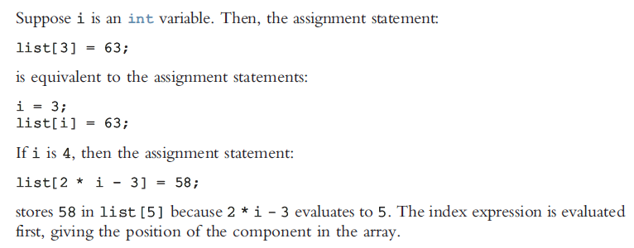
Accessing Array Components (cont'd.)

Slide 14
Accessing Array Components (cont'd.)
Array can also be declared as
const int SIZE_OF_ARRAY = 20;
int array[SIZE_OF_ARRAY] ;
First declare a named constant and then use it to declare an array of this specific size.
When an array is declared its size must be known. You cannot do this:
int arr_size;
cout << "Enter size of array ";
cin >> arr_size;
int arr[arr_size];

Slide 15
Processing One-Dimensional Arrays
Some basic operations performed on a one-dimensional array are:
Initializing
Inputting data
Outputting data stored in an array
Finding the largest and/or smallest element
Each operation requires ability to step through the elements of the array
Easily accomplished by a loop

Slide 16
Processing One-Dimensional Arrays (cont'd.)
Consider the declaration
int list[100]; //array of size 100
int i;
Using for loops to access array elements:
for (i = 0; i < 100; i++) //Line 1
//process list[i] //Line 2
Example:
for (i = 0; i < 100; i++) //Line 1
cin >> list[i]; //Line 2

Slide 17
Processing One-Dimensional Arrays (cont'd.)
double scores[10];
int index;
double largest, sum, average;
Initializing an array
for (index = 0 ; index < 10 ; ++index)
scores[index] = 0.0 ;
Reading data into array
for (index = 0 ; index < 10 ; ++index)
cin >> scores[index] ;
Printing the array
for (index = 0 ; index < 10 ; ++index)
cout << scores[index] << “ ”;

Slide 18
Processing One-Dimensional Arrays (cont'd.)
Finding sum and average of an array
sum = 0.0;
for (index = 0 ; index < 10 ; ++index)
sum = sum + scores[index];
average = sum / 10;
Largest element in the array
maxIndex = 0;
for (index = 1 ; index < 10 ; ++index)
if (scores[maxIndex] < scores[index])
maxIndex = index;
largest = scores[maxIndex];

Slide 19
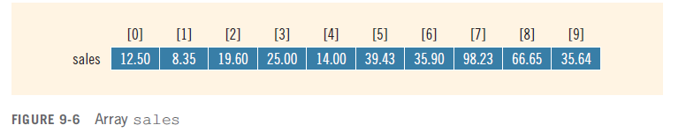
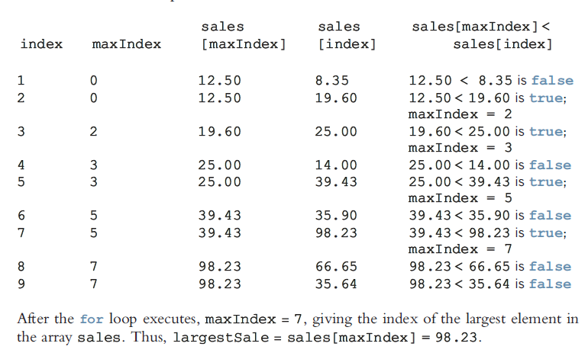
Processing One-Dimensional Arrays

Slide 20
Arrays by an Example …
1 // C++ Program
2 // Initializing an array.
3 #include <iostream>
4
5 using std::cout;
6 using std::endl;
7
8 #include <iomanip>
9
10 using std::setw;
11
12 int main()
13 {
14 int n[ 10 ]; // n is an array of 10 integers
15
16 // initialize elements of array n to 0
17 for ( int i = 0; i < 10; i++ )
18 n[ i ] = 0; // set element at location i to 0
19
20 cout << "Element" << setw( 13 ) << "Value" << endl;
21
22 // output contents of array n in tabular format
23 for ( int j = 0; j < 10; j++ )
24 cout << setw( 7 ) << j << setw( 13 ) << n[ j ] << endl;
25
26 return 0; // indicates successful termination
27
28 } // end main
Declare a 10-element array of integers.
Initialize array to 0 using a for loop. Note that the array has elements n[0] to n[9].

Slide 21
Output
Element Value
0 0
1 0
2 0
3 0
4 0
5 0
6 0
7 0
8 0
9 0

Slide 22
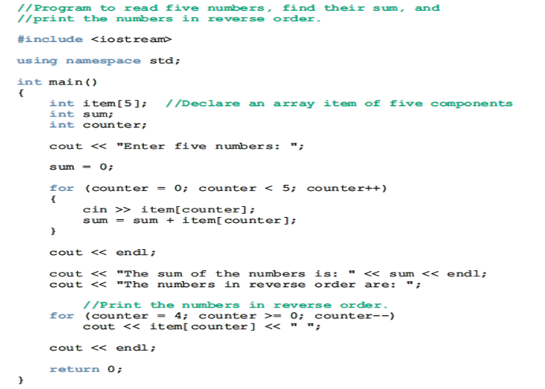
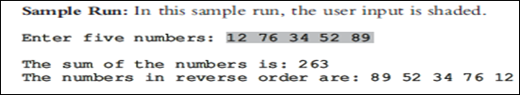
Example

Slide 23
Array Index Out of Bounds
If we have the statements:
const ARRAY_SIZE = 10;
double num[ARRAY_SIZE];
int i;
The component num[i] is valid if i = 0, 1, 2, 3, 4, 5, 6, 7, 8, or 9
The index of an array is in bounds if the index >=0 and the index <= ARRAY_SIZE-1
Otherwise, we say the index is out of bounds
In C++, there is no guard against indices that are out of bounds

Slide 24
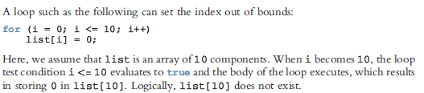
Array Index Out of Bounds

Slide 25
How array element is calculated
Each element is placed at consecutive location
We can calculate address of any element of array by performing simple arithmetic
address_of_index_x = base_address + size_of_datatype * x
Example
int array[10] ;
Assume this array starts at address 100 in memory. To calculate address of index 5.
address_of_index_5 = 100 + 4*5 = 120
Note: Compiler just knows the address of the first element of the array known as the base address of the array. All other indexes are calculated relative to base address.
[0] | [1] | [2] | [3] | [4] | [5] | [6] | [7] | [8] | [9]
100 103 | 107 | 108 111 | 112 115 | 116 119 | 120 123 | 124 127 | 128 131 | 132 135 | 139

Slide 26

How array element is calculated
Can we have –ve indexes in the array
Like array[-2]

Slide 27
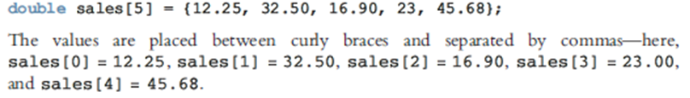
Array Initialization During Declaration
Arrays can be initialized during declaration
In this case, it is not necessary to specify the size of the array
Size determined by the number of initial values in the braces
Example:
double sales[] = {12.25, 32.50, 16.90, 23, 45.68};

Slide 28
Partial Initialization of Arrays During Declaration
The statement:
int list[10] = {0};
declares list to be an array of 10 components and initializes all of them to zero
The statement:
int list[10] = {8, 5, 12};
declares list to be an array of 10 components, initializes list[0] to 8, list[1] to 5, list[2] to 12 and all other components are initialized to 0

Slide 29
Partial Initialization of Arrays During Declaration (cont'd.)
The statement:
int list[] = {5, 6, 3};
declares list to be an array of 3 components and initializes list[0] to 5, list[1] to 6, and list[2] to 3

Slide 30
Partial Initialization of Arrays During Declaration (cont'd.)
int list[10] = {2, 5, 6, , 8}; //illegal
In this initialization, because the fourth element is uninitialized, all elements that follow the fourth element must be left uninitialized

Slide 31
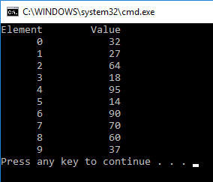
Arrays by an Example II …
1 // C++ Program
2 // Initializing an array with a declaration.
3 #include <iostream>
4
5 using std::cout;
6 using std::endl;
7
8 #include <iomanip>
9
10 using std::setw;
11
12 int main()
13 {
14 // use initializer list to initialize array n
15 int n[ 10 ] = { 32, 27, 64, 18, 95, 14, 90, 70, 60, 37 };
16
17 cout << "Element" << setw( 13 ) << "Value" << endl;
18
19 // output contents of array n in tabular format
20 for ( int i = 0; i < 10; i++ )
21 cout << setw( 7 ) << i << setw( 13 ) << n[ i ] << endl;
22
23 return 0; // indicates successful termination
24
25 } // end main
Note the use of the initializer list.

Slide 32
Some Restrictions on Array Processing
Consider the following statements:
int myList[5] = {0, 4, 8, 12, 16}; //Line 1
int yourList[5]; //Line 2
C++ does not allow aggregate operations on an array:
youtList = myList ; //illegal
Solution:
for(int i = 0 ; i < 5 ; ++i)
yourList[i] = myList[i] ;

Slide 33
Some Restrictions on Array Processing (cont'd.)
The following is illegal too:
cin >> yourList ; //illegal
Solution:
for(int i=0 ; i<5 ; ++i)
cin >> yourList[i] ;
The following statements are legal, but do not give the desired results:
cout << yourList ;
if(myList <= yourList)
.
.
.

Slide 34
Examples Using Arrays
Array size
Can be specified with constant variable (const)
const int size = 20;
Constants cannot be changed
Constants must be initialized when declared
Also called named constants or read-only variables

Slide 35
Arrays by an Example - III …
1 // C++ Program
2 // Initialize array s to the even integers from 2 to 20.
3 #include <iostream>
4
5 using std::cout;
6 using std::endl;
7
8 #include <iomanip>
9
10 using std::setw;
11
12 int main()
13 {
14 // constant variable can be used to specify array size
15 const int arraySize = 10;
16
17 int s[ arraySize ]; // array s has 10 elements
18
19 for ( int i = 0; i < arraySize; i++ ) // set the values
20 s[ i ] = 2 + 2 * i;
21
22 cout << "Element" << setw( 13 ) << "Value" << endl;
23
24 // output contents of array s in tabular format
25 for ( int j = 0; j < arraySize; j++ )
26 cout << setw( 7 ) << j << setw( 13 ) << s[ j ] << endl;
27
28 return 0; // indicates successful termination
29
30 } // end main
Note use of const keyword. Only const variables can specify array sizes.
The program becomes more scalable when we set the array size using a const variable. We can change arraySize, and all the loops will still work (otherwise, we’d have to update every loop in the program).

Slide 36
Program Output …
Element Value
0 2
1 4
2 6
3 8
4 10
5 12
6 14
7 16
8 18
9 20

Slide 37
Arrays by an Example -IV…
1 // C++ Program
2 // Compute the sum of the elements of the array.
3 #include <iostream>
4
5 using std::cout;
6 using std::endl;
7
8 int main()
9 {
10 const int arraySize = 10;
11
12 int a[ arraySize ] = { 1, 2, 3, 4, 5, 6, 7, 8, 9, 10 };
13
14 int total = 0;
15
16 // sum contents of array a
17 for ( int i = 0; i < arraySize; i++ )
18 total += a[ i ];
19
20 cout << "Total of array element values is " << total << endl;
21
22 return 0; // indicates successful termination
23
24 } // end main
Output:
Total of array element values is 55

Slide 38
Arrays by an Example -V…
1 // C++ Program
2 // Histogram printing program.
3 #include <iostream>
4
5 using std::cout;
6 using std::endl;
7
8 #include <iomanip>
9
10 using std::setw;
11
12 int main()
13 {
14 const int arraySize = 10;
15 int n[ arraySize ] = { 19, 3, 15, 7, 11, 9, 13, 5, 17, 1 };
16
17 cout << "Element" << setw( 13 ) << "Value"
18 << setw( 17 ) << "Histogram" << endl;
19
20 // for each element of array n, output a bar in histogram
21 for ( int i = 0; i < arraySize; ++i ) {
22 cout << setw( 7 ) << i << setw( 13 )
23 << n[ i ] << setw( 9 );
24
25 for ( int j = 0; j < n[ i ]; ++j ) // print one bar
24 cout << '*';
Prints asterisks corresponding to size of array element, n[i].

Slide 39
Arrays by an Example -V…
27
28 cout << endl; // start next line of output
29
30 } // end outer for structure
31
32 return 0; // indicates successful termination
33
34 } // end main
Program Output …
Element Value Histogram
0 19 *******************
1 3 ***
2 15 ***************
3 7 *******
4 11 ***********
5 9 *********
6 13 *************
7 5 *****
8 17 *****************
9 1 *

Slide 40
Arrays by an Example –VI …
1 // C++ Program
2 // Roll a six-sided die 6000 times.
3 #include <iostream>
4
5 using std::cout;
6 using std::endl;
7
8 #include <iomanip>
9
10 using std::setw;
11
12 #include <cstdlib>
13 #include <ctime>
14
15 int main()
16 {
17 const int ARRAY_SIZE= 7;
18 int frequency[ARRAY_SIZE ] = { 0 };
19
20 srand( time( 0 ) ); // seed random-number generator
21
22 // roll dice 6000 times
23 for ( int roll = 1; roll <= 6000; roll++ )
24 ++frequency[ 1 + rand() % 6 ];
An array is used instead of 6 regular variables, and the proper element can be updated
This creates a number between 1 and 6, which determines the index of frequency[] that should be incremented.

Slide 41
26
27 cout << "Face" << setw( 13 ) << "Frequency" << endl;
28
29 // output frequency elements 1-6 in tabular format
30 for ( int face = 1; face < ARRAY_SIZE; face++ )
31 cout << setw( 4 ) << face
32 << setw( 13 ) << frequency[ face ] << endl;
33
34 return 0; // indicates successful termination
35
36 } // end main
Program Output …
Face Frequency
1 1003
2 1004
3 999
4 980
5 1013
6 1001

Slide 42
Arrays by an Example –VII …
1 // C++ Program
2 // Student poll program.
3 #include <iostream>
4
5 using std::cout;
6 using std::endl;
7
8 #include <iomanip>
9
10 using std::setw;
11
12 int main()
13 {
14 // define array sizes
15 const int RESPONSE_SIZE = 40; // size of array responses
16 const int FREQUENCY_SIZE = 11; // size of array frequency
17
18 // place survey responses in array responses
19 int responses[RESPONSE_SIZE ] = { 1, 2, 6, 4, 8, 5, 9, 7, 8,
20 10, 1, 6, 3, 8, 6, 10, 3, 8, 2, 7, 6, 5, 7, 6, 8, 6, 7,
21 5, 6, 6, 5, 6, 7, 5, 6, 4, 8, 6, 8, 10 };
22
23 // initialize frequency counters to 0
24 int frequency[FREQUENCY_SIZE ] = { 0 };
25

Slide 43
26 // for each answer, select value of an element of array
27 // responses and use that value as subscript in array
28 // frequency to determine element to increment
29 for ( int answer = 0; answer < RESPONSE_SIZE; answer++ )
30 ++frequency[ responses[answer] ];
31
32 // display results
33 cout << "Rating" << setw( 17 ) << "Frequency" << endl;
34
35 // output frequencies in tabular format
36 for ( int rating = 1; rating < FREQUENCY_SIZE ; rating++ )
37 cout << setw( 6 ) << rating
38 << setw( 17 ) << frequency[ rating ] << endl;
39
40 return 0; // indicates successful termination
41
42 } // end main
responses[answer] is the rating (from 1 to 10). This determines the index in frequency[] to increment.

Slide 44
Program Output …
Rating Frequency
1 2
2 2
3 2
4 2
5 5
6 11
7 5
8 7
9 1
10 3

Slide 45
Questions

